Slide 1

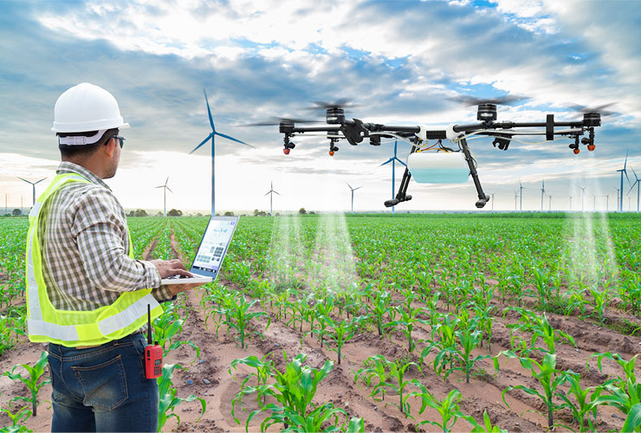
New inventions in Agriculture
Group Members :-
P. Tharun
K. Hrishikesh Reddy
G .Karthik Reddy

Slide 2
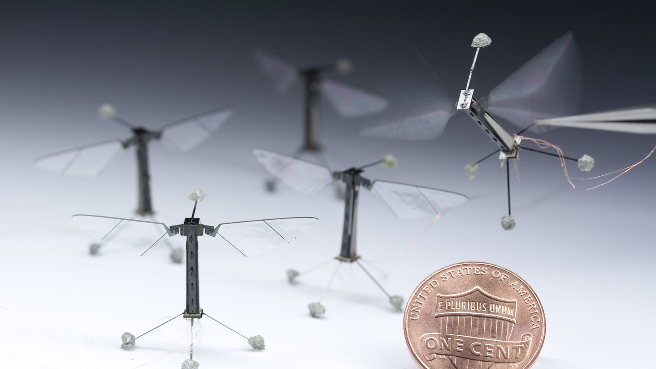
Introduction:-
Emerging agriculture trends mark a shift towards smart farming and efficient utilization of time and resources while reducing crop losses
Robots and drones are accelerating farm automation by replacing manual farm operations such as picking fruits, killing weeds, or water spraying.
Technological advancements in the agriculture sector meet the growing demand for farm automation, digitalization, and sustainability.
This Photo by Unknown author is licensed under CC BY-SA.

Slide 3
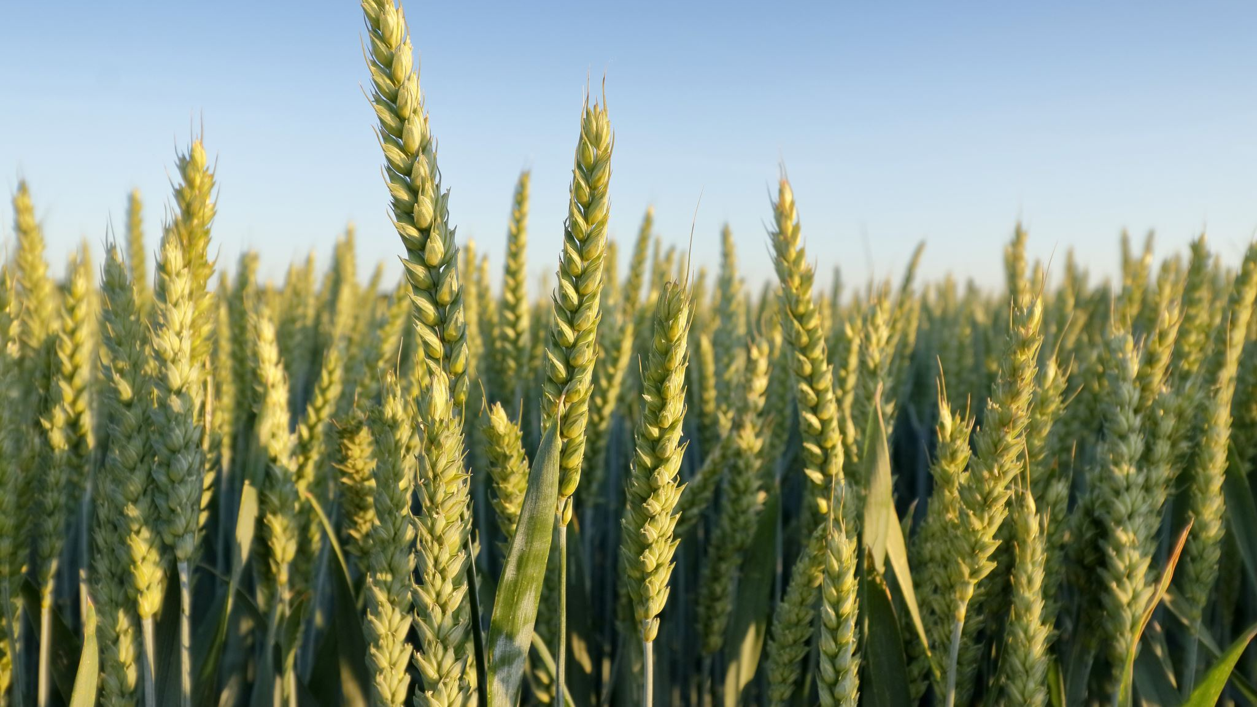
New Innovations & Technology
Smart farming is an upcoming concept that deploys technologies like ….
--> Internet of Things (IoT)
--> Computer Vision
--> Artificial Intelligence (AI) for farming.
--> Robotics
--> Drones

Slide 4
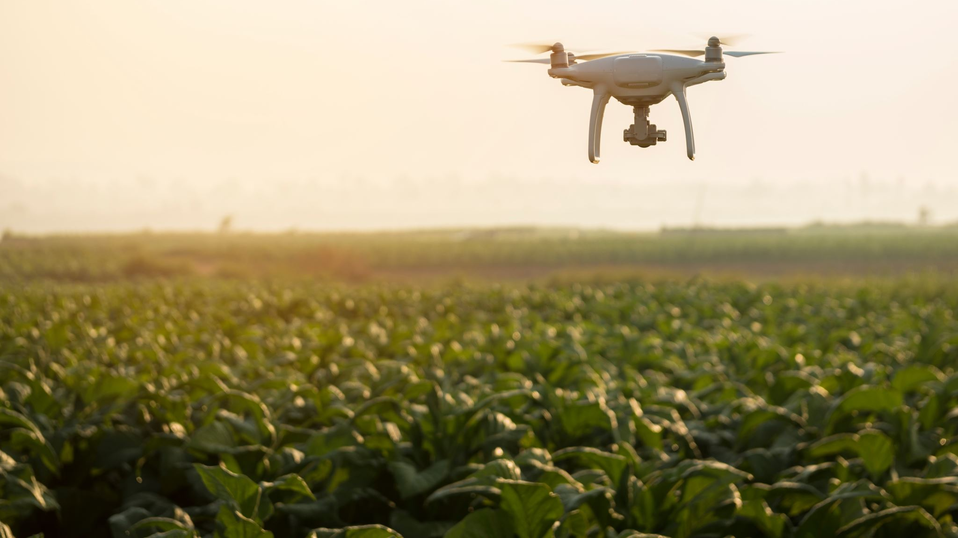
Further, IoT devices, powered by sensor technology, collect real-time field data that allow farmers to make data-driven decisions.
The Main motto of our Website is to create awareness among Farmers.
About the New innovations and the New technology in current world.
Farmers can know about these modern technology and reduce their cost, Reduce their work and Increase the Livelihood

Slide 5


